Slide 1
DARK WEB MONITORING
Members:
Subrat Kumar Swain
Sidharth Choudhury
By Team: Gavilan

Slide 2
Functionalities
Find Onion Links from different search engines [Ahmia, Torch, Not Evil, Deep Search] .
Gives a Preview of the website.
Maintain an archive of the links visited.
Provides the relays used to connect to the server.

Slide 3
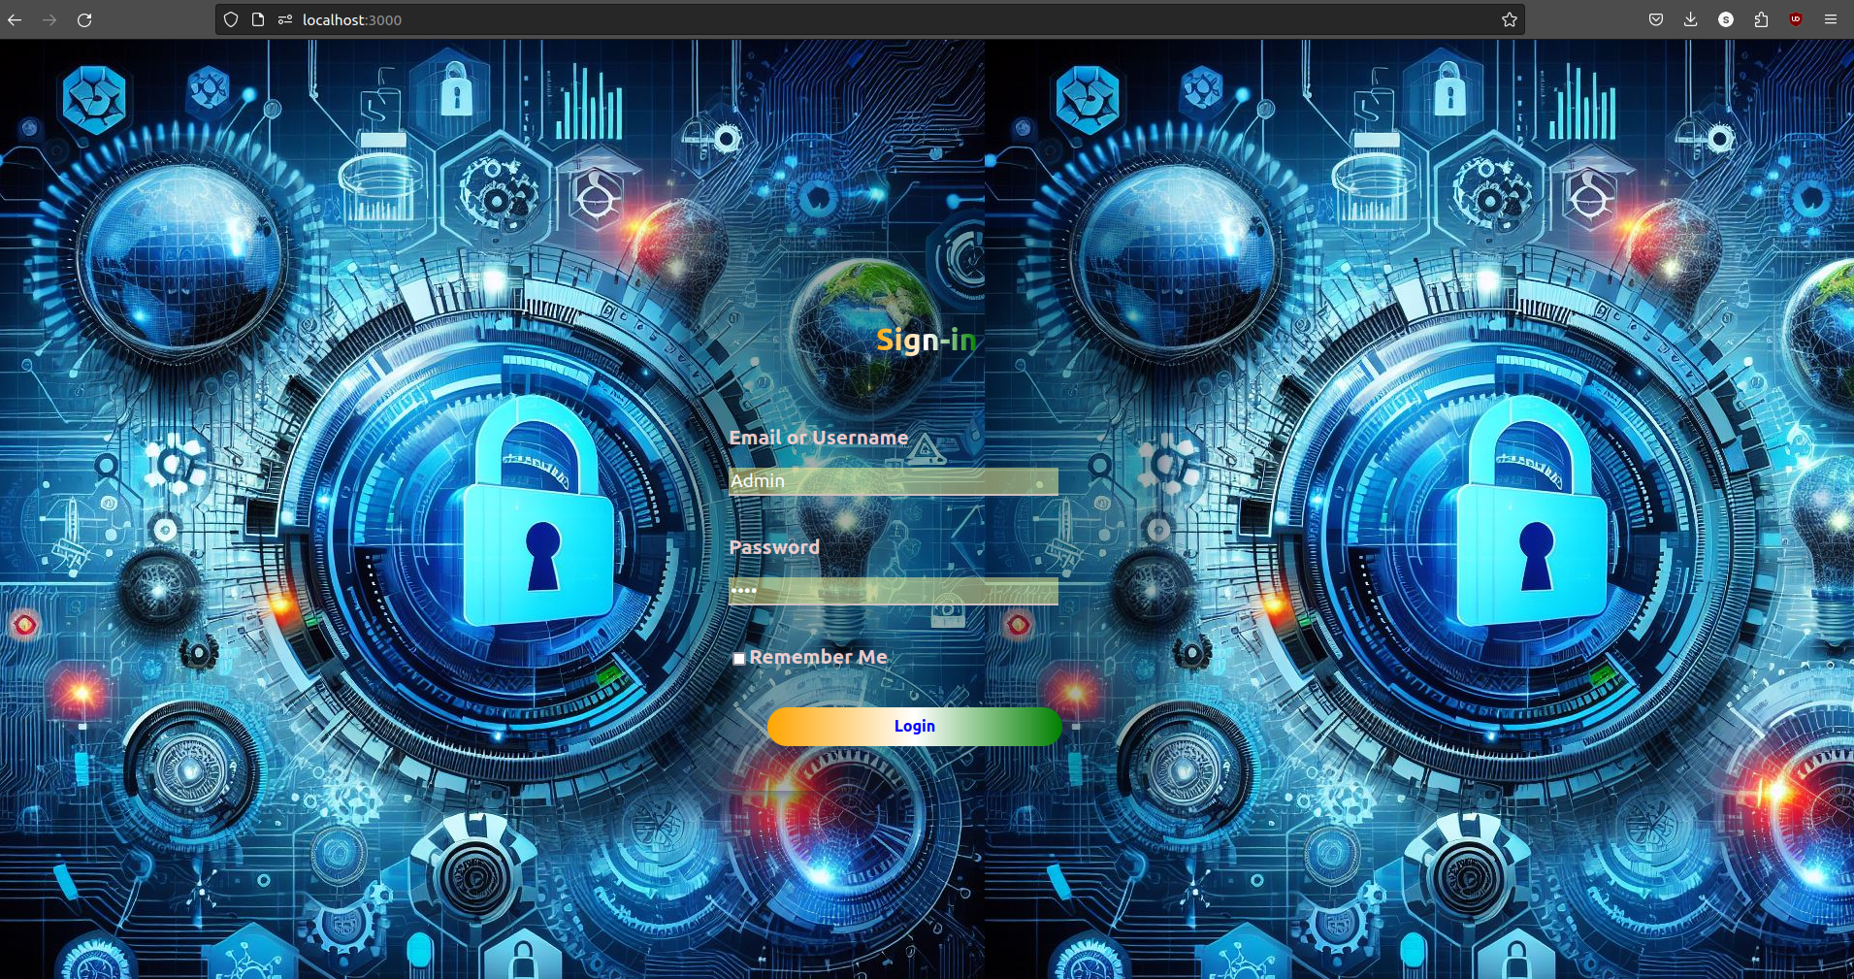

Slide 4
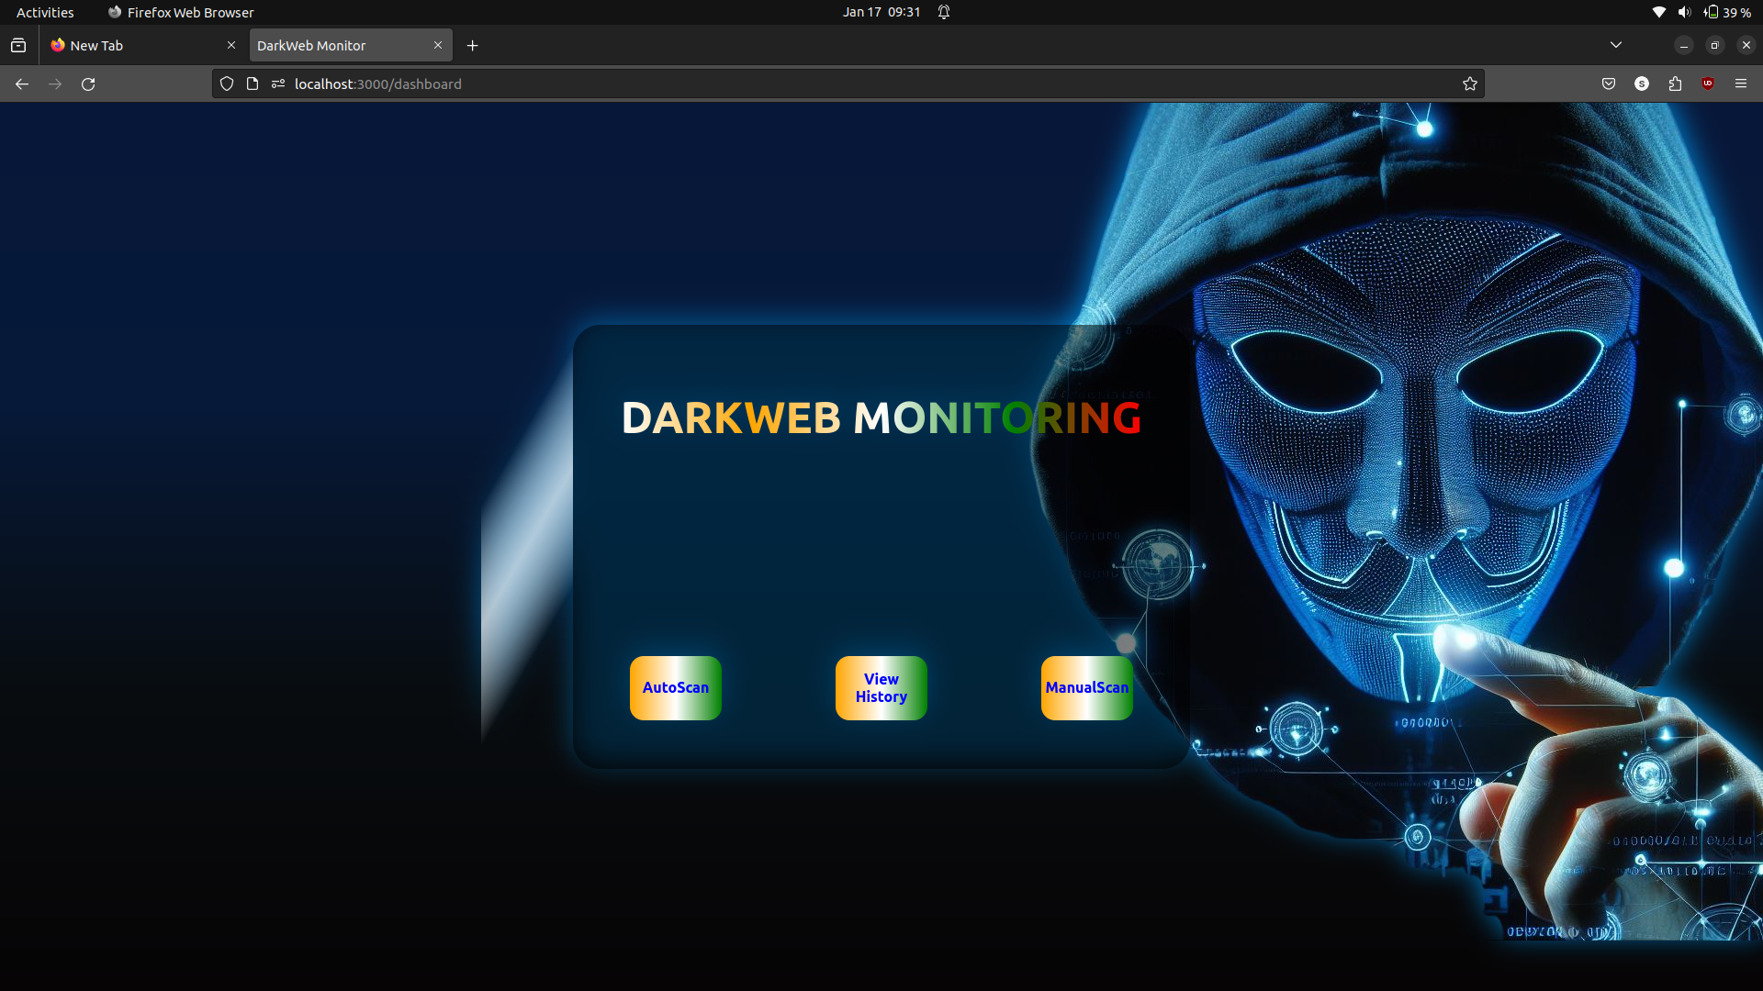
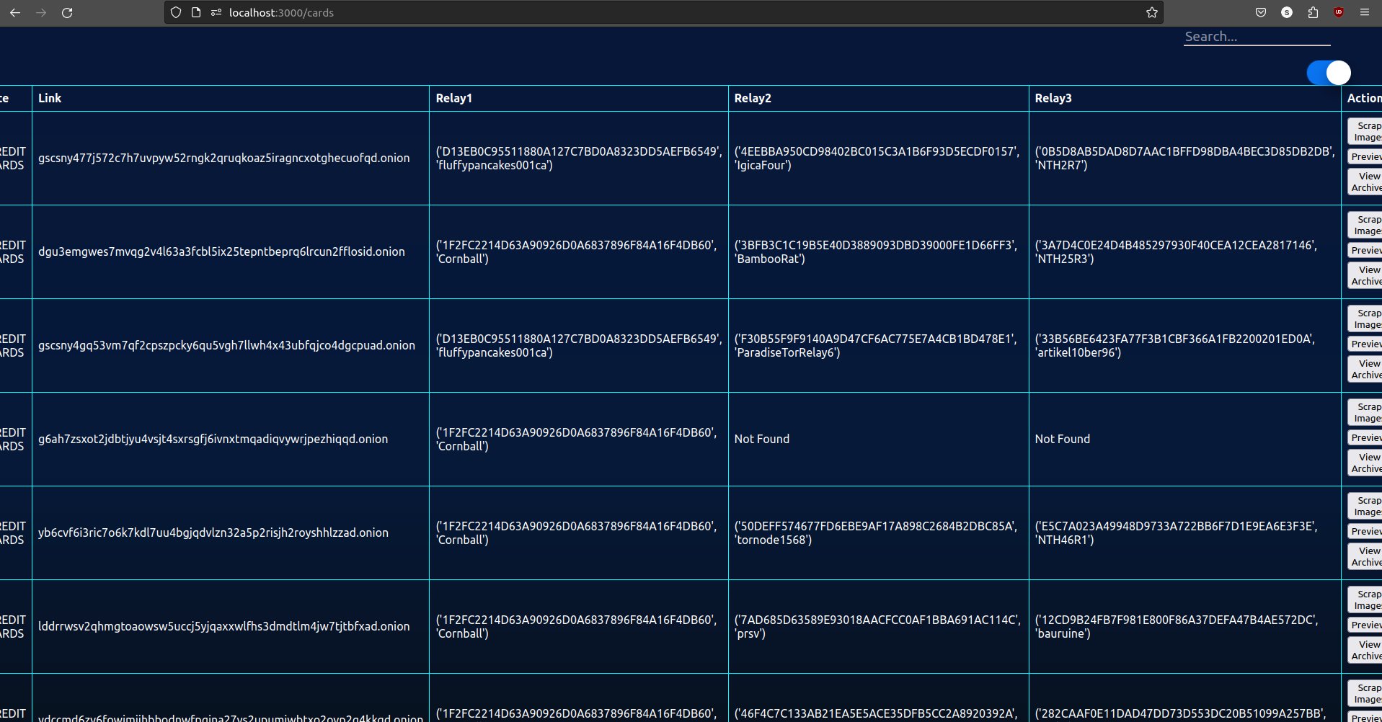
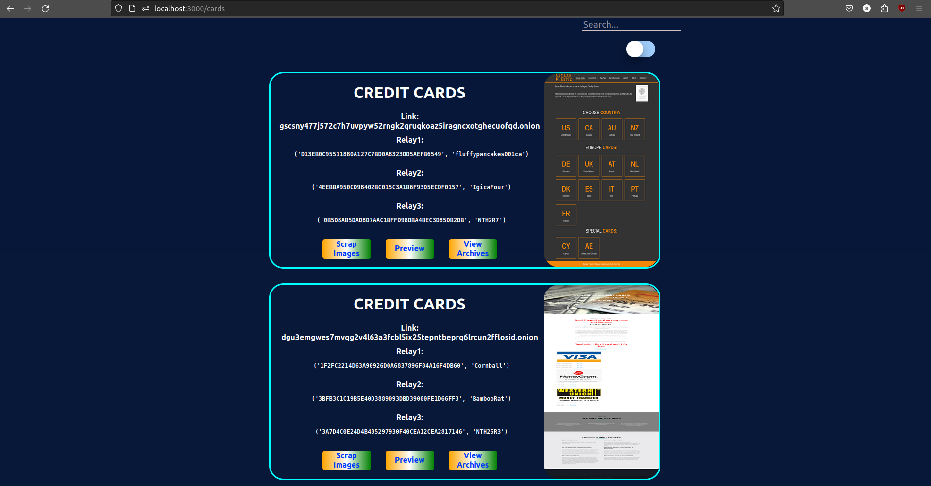
Onion Link Search
Manual Scan
This would manually scan for the links based on keywords provided.

Slide 5
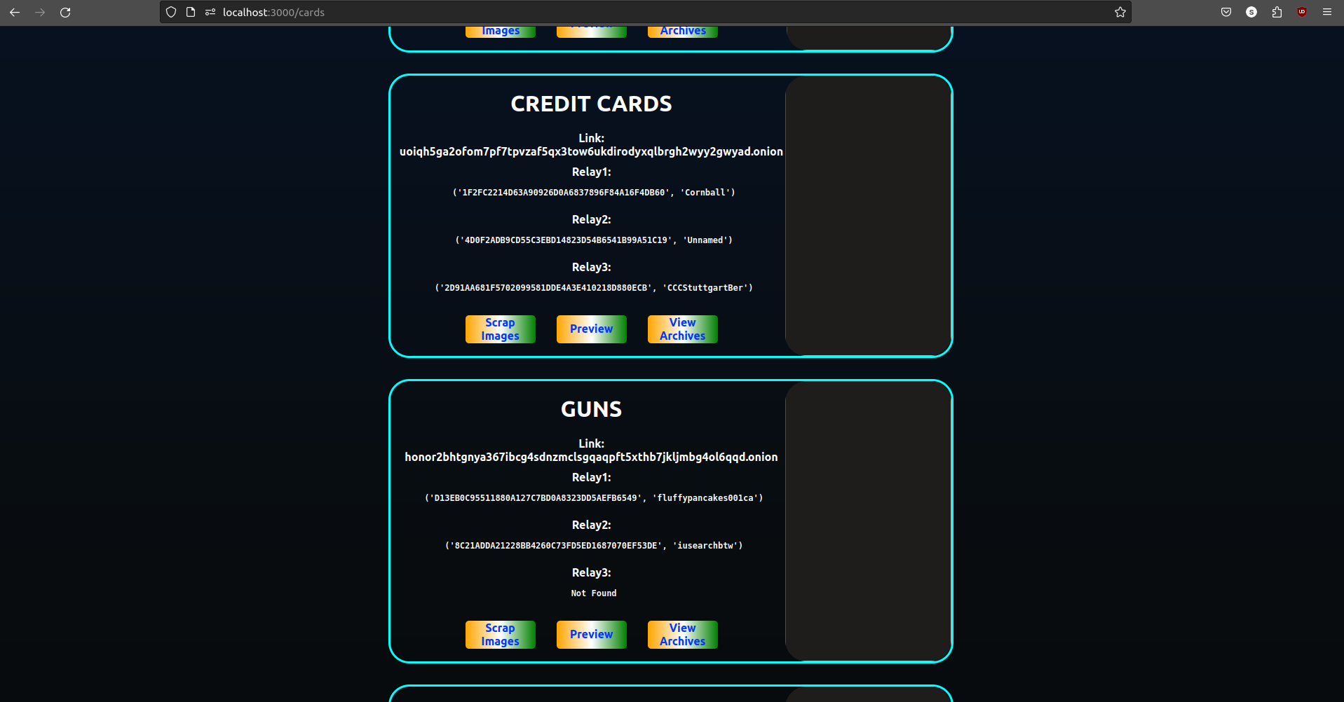
Onion Link Search
Auto Scan
This would automatically scan for the links.

Slide 6
View History
Shows an archive of the websites if previewed before.
This contains:
Timestamp
Relays Information
Importance of Archives
Website Evolution: Archives provide a historical record of a website's past versions and activities, allowing for tracking changes and understanding its evolution.

Slide 7
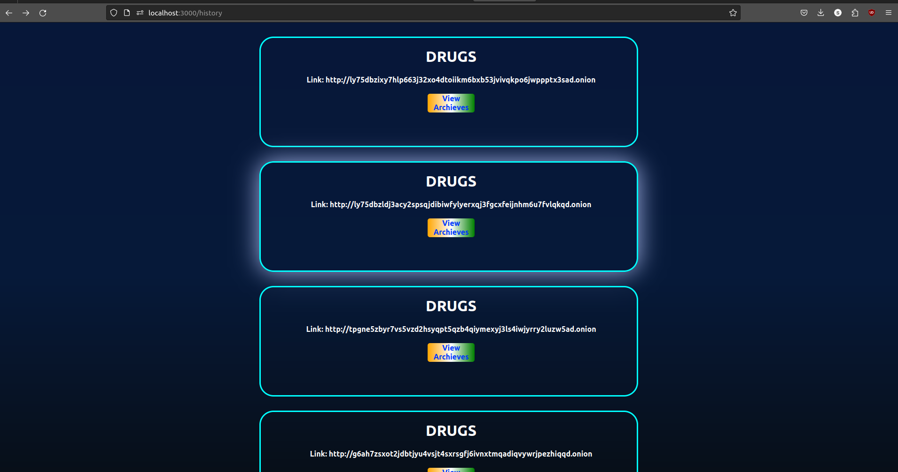
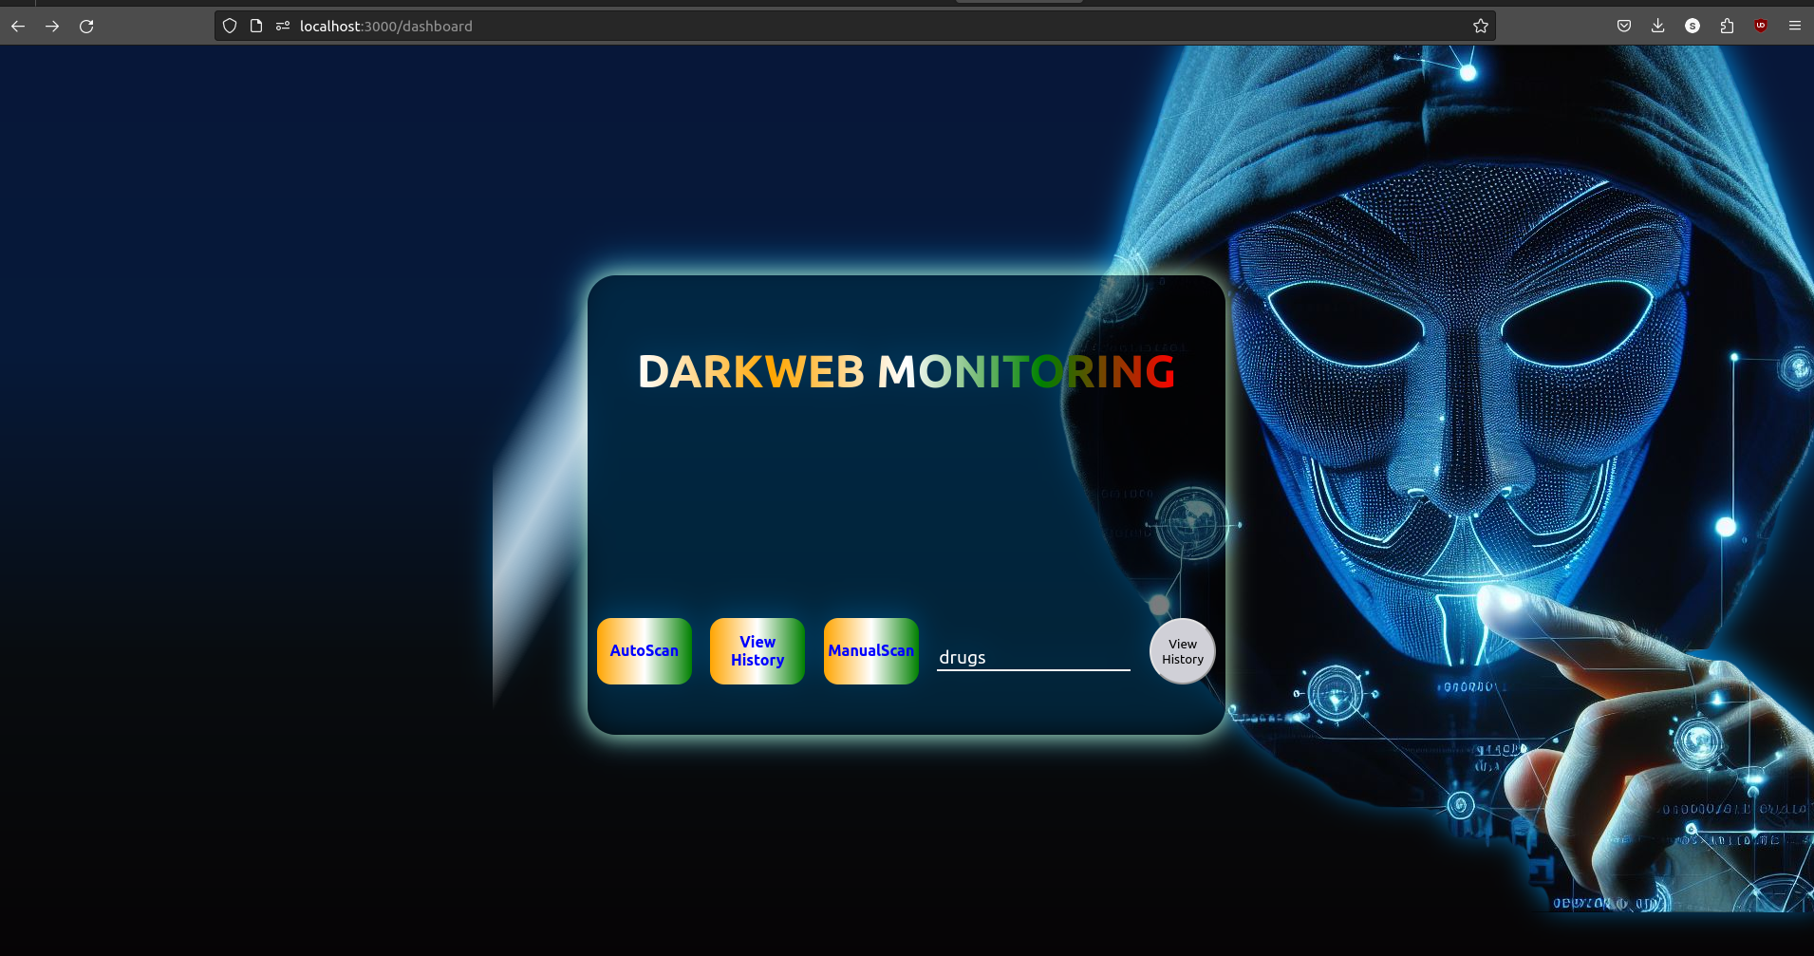
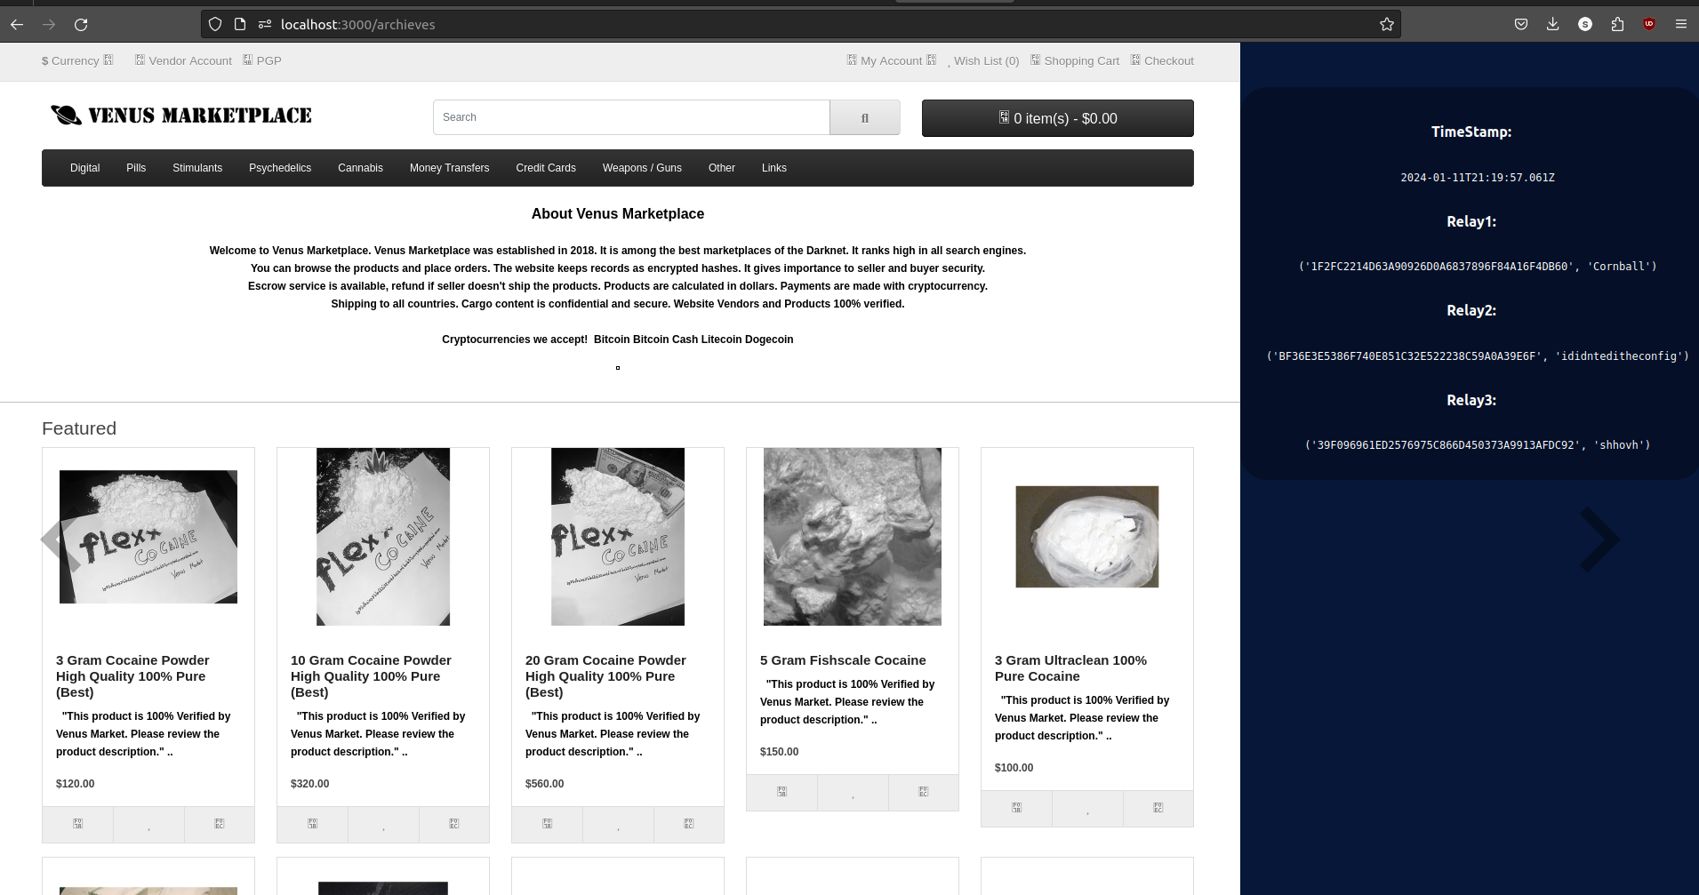

Slide 8
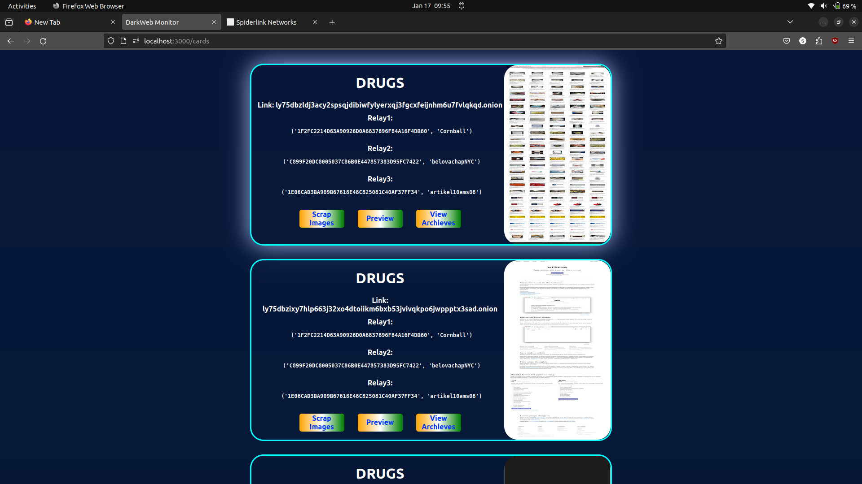
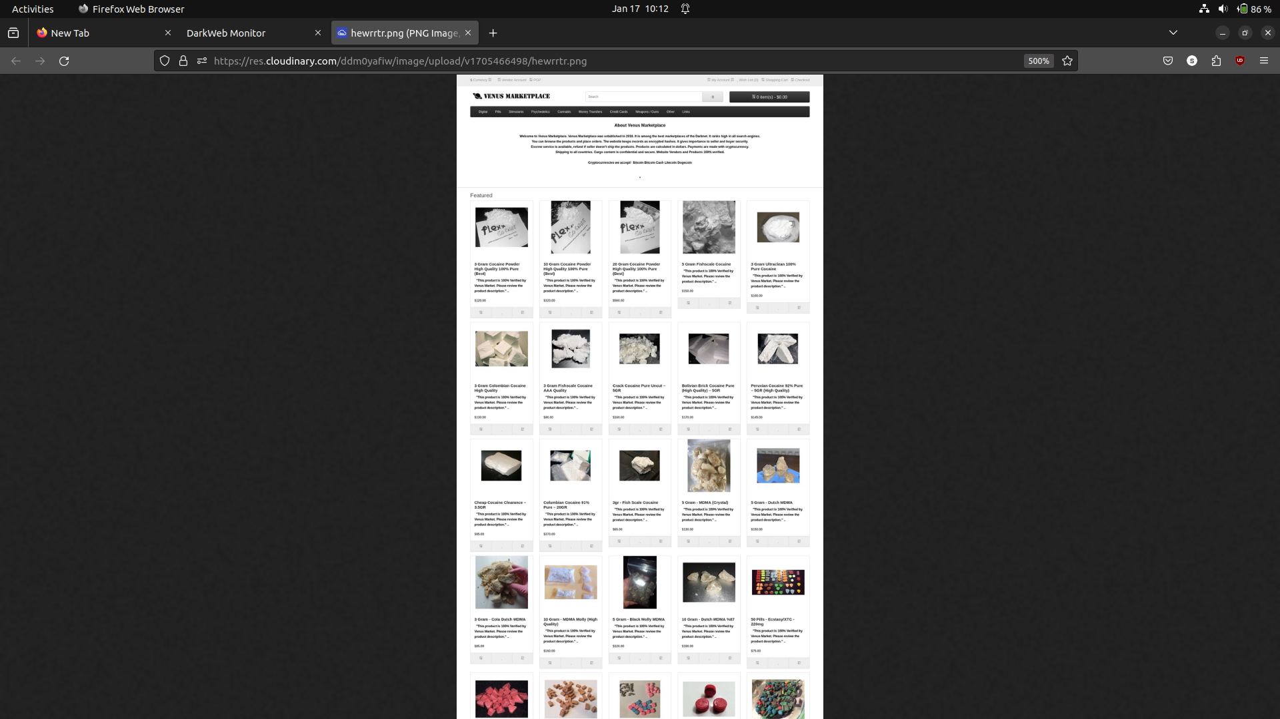
Preview
Takes the screenshot/ Preview of the Webpage.

Slide 9
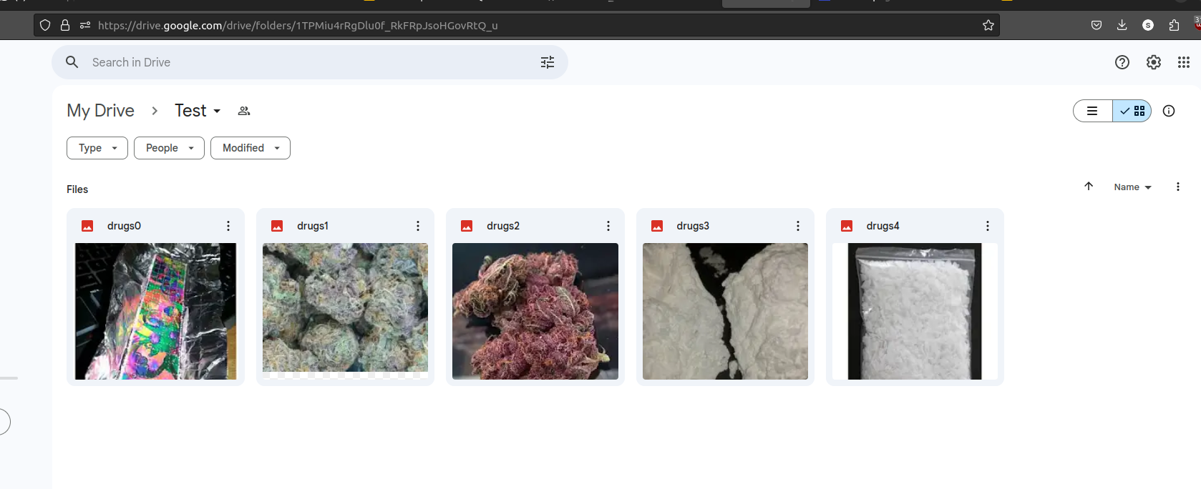
Scrap Images
This involves extracting images from websites and store them in a cloud drive .
Benefits of Image Extraction and Cloud Storage
Easy access to images from multiple devices
Efficient sharing and collaboration on image-based projects

Slide 10
IP Tracking
This shows the relay informations(Public Fingerprint) through which the onion site is being visited.

Slide 11
THANK YOU

